Slide 1
Reconstructing a simple 3D object using phase-shift coherence holography

Slide 2
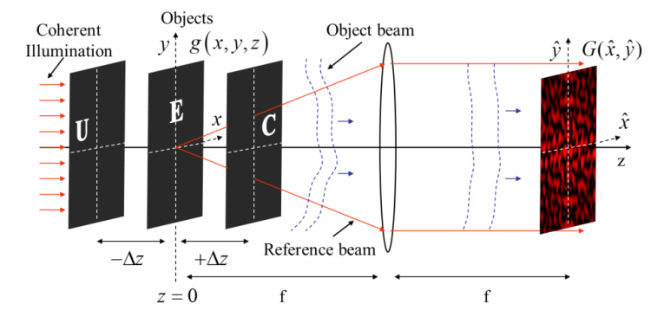
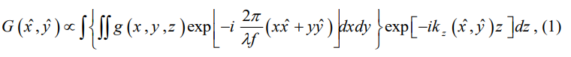
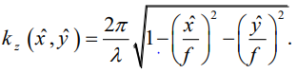
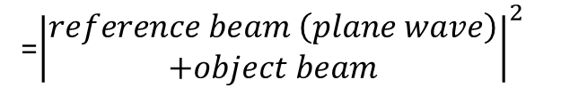
Generation of a Fourier transform coherence hologram
U
Coherence source
E
Recorded Hologram
=${\left|\begin{aligned}reference beam \left(plane wave\right) \\ +object beam\end{aligned}\right|}^{2}$
-10mm
10mm
Figure 1
Object beam at hologram plane:
Defocus and propagation of the angular spectrum
Fourier Transform (Based on Fraunhofer diffraction)

Slide 3
Phase-shift holograms
A set of phase-shift holograms are generated numerically by giving known phase shifts to the object spectrum
There is a term ${\left|G\left(\hat{x},\hat{y}\right)\right|}^{2}$that is the source of unwanted autocorrelation image→ numerically eliminate this term

Slide 4
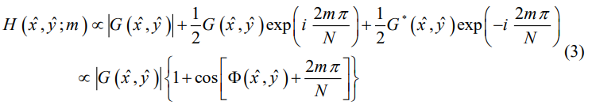
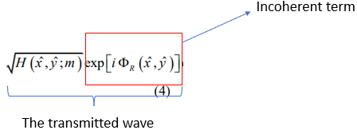
Intensity transmittance of the hologram
Unlike conventional hologram, the intensity (rather than amplitude) transmittance of the hologram was made proportional to the interference fringe pattern
Incoherence illumination

Slide 5
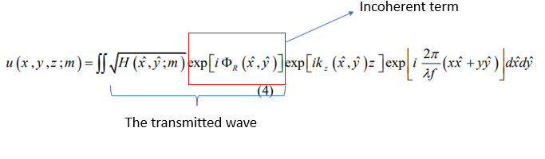
Incoherence Illumination
U
E
-10mm
10mm
Figure 1

Slide 6
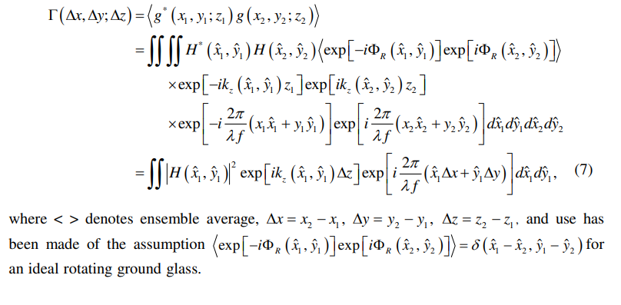
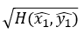
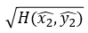
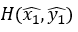
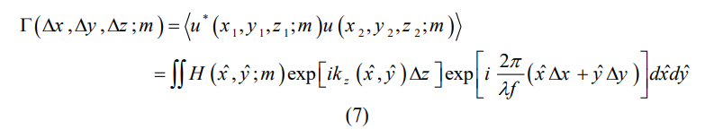
Coherence function- used to reconstruct the object
:Correlation of 2 signals
IFFT of the Intensity transmittance hologram
Definition of impulse response
Adding phase-shift

Slide 7
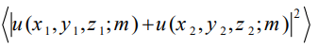
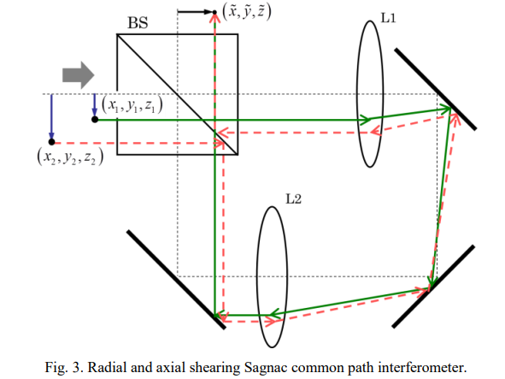
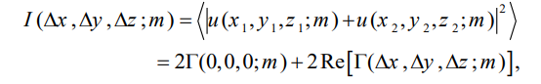
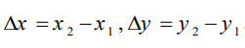
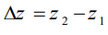
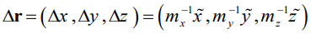
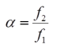
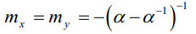
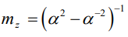
Sagnac Interferometer- CCD captures the interference of this interferometer

Slide 8
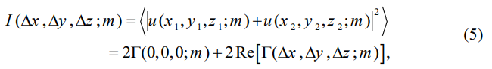
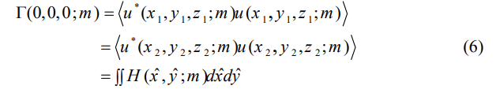
The equation of CCD image
Background
Coherence function

Slide 9
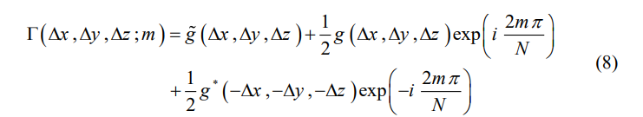
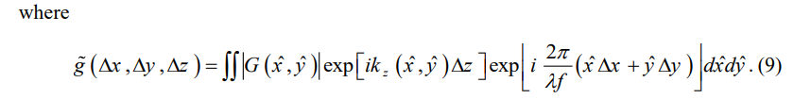
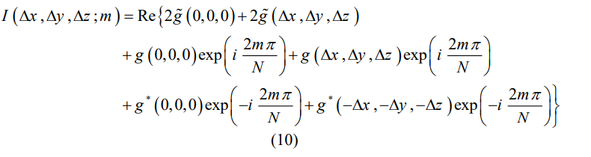
The purpose of adding phase-shift to the holograms
From (3) and (7)
CCD image
Vary sinusoidally -> Sin-fit Algorithm

Slide 10
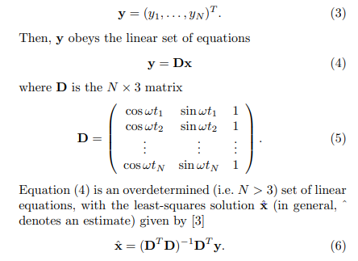
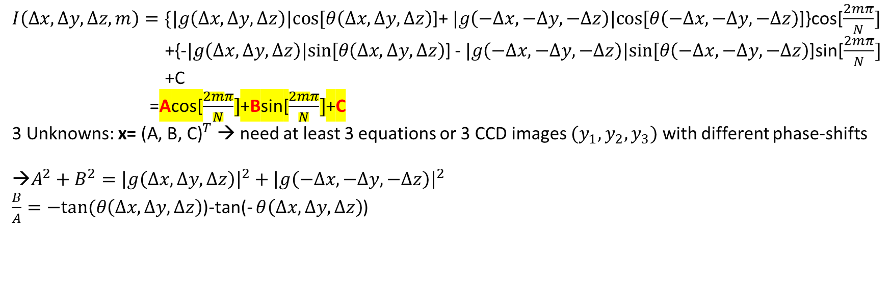
The purpose of adding phase-shift to the holograms
$I\left(∆x,∆y,∆z,m\right)=\{|g\left(∆x,∆y,∆z\right)|cos⁡[θ\left(∆x,∆y,∆z\right)$]+ $|g\left(−∆x,−∆y,−∆z\right)|cos⁡[θ\left(−∆x,−∆y,−∆z\right)$]}cos[$\frac{2mπ}{N}]$
+{-$|g\left(∆x,∆y,∆z\right)|sin⁡[θ\left(∆x,∆y,∆z\right)$] - $|g\left(−∆x,−∆y,−∆z\right)|sin⁡[θ\left(−∆x,−∆y,−∆z\right)$]sin[$\frac{2mπ}{N}]$
+C
=Acos[$\frac{2mπ}{N}]$+Bsin[$\frac{2mπ}{N}]$+C
3 Unknowns: ${\text{x}\text{= }\text{(}\text{A}\text{, }\text{B}\text{, }\text{C}\text{)}}^{T}$ → need at least 3 equations or 3 CCD images $(y_{1},y_{2},y_{3})$ with different phase-shifts
→$A^{2}+B^{2}={\left|g\left(∆x,∆y,∆z\right)\right|}^{2}+{\left|g\left(−∆x,−∆y,−∆z\right)\right|}^{2}$
$\frac{B}{A}=−tan⁡(θ\left(∆x,∆y,∆z\right)$)-tan(- $θ\left(∆x,∆y,∆z\right)$)

Slide 11
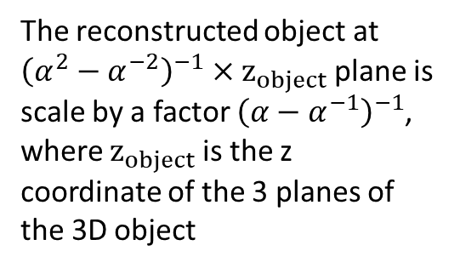
The Reconstructed object
The reconstructed object at ${\left(α^{2}−α^{−2}\right)}^{−1}×z_{object}$ plane is scale by a factor ${\left(α−α^{−1}\right)}^{−1}$, where $z_{object}$ is the z coordinate of the 3 planes of the 3D object

Slide 12
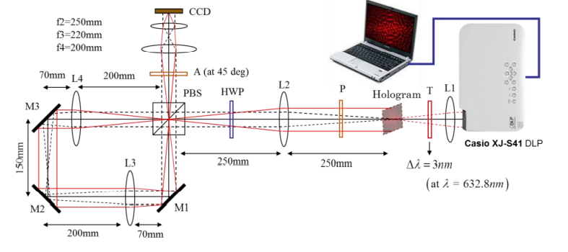
The setup to record the CCD images
Fourier Transform (Based on Fraunhofer diffraction)
Interferometer

Slide 13
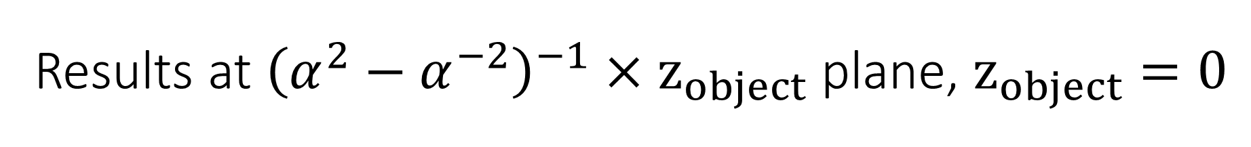
Results at ${\left(α^{2}−α^{−2}\right)}^{−1}×z_{object}$ plane, $z_{object}=0$
The conjugate object’s amplitude
The object’s amplitude
Reconstructed object’s amplitude from IEEE paper
Reconstructed object’s phase from IEEE paper
One of the CCD images

Slide 14

Results at ${\left(α^{2}−α^{−2}\right)}^{−1}×z_{object}$ plane, $z_{object}=−10mm$
Reconstructed object’s amplitude from IEEE paper
Reconstructed object’s phase from IEEE paper
One of the CCD images

Slide 15

Results at ${\left(α^{2}−α^{−2}\right)}^{−1}×z_{object}$ plane, $z_{object}=10mm$
Reconstructed object’s amplitude from IEEE paper
Reconstructed object’s phase from IEEE paper
One of the CCD images

Slide 16
References
(1) D. N. Naik, T. Ezawa, R. K. Singh, Y. Miyamoto, and M. Takeda, “Coherence holography by achromatic 3-D field correlation of generic thermal light with an imaging Sagnac shearing interferometer”, 2012 Optical Society of America
(2) P. H¨andel, Senior Member, IEEE , “Properties of the IEEE-STD-1057 four parameter sine wave fit algorithm”, IEEE January 2001
(3) D. N. Naik, T. Ezawa, Y. Miyamoto, and M. Takeda, “Real-time coherence holography”, 2010 Optical Society of America

